Slide 1


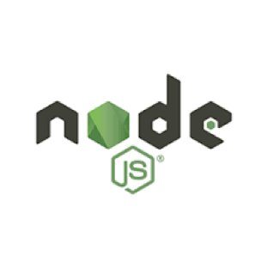
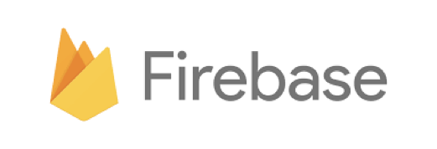
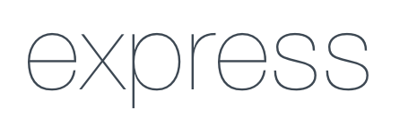

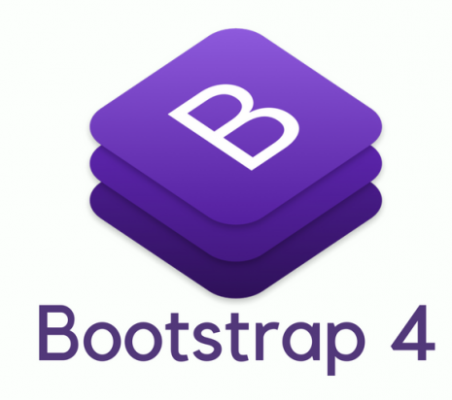


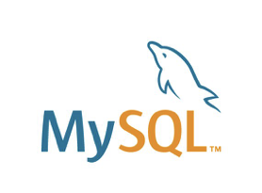
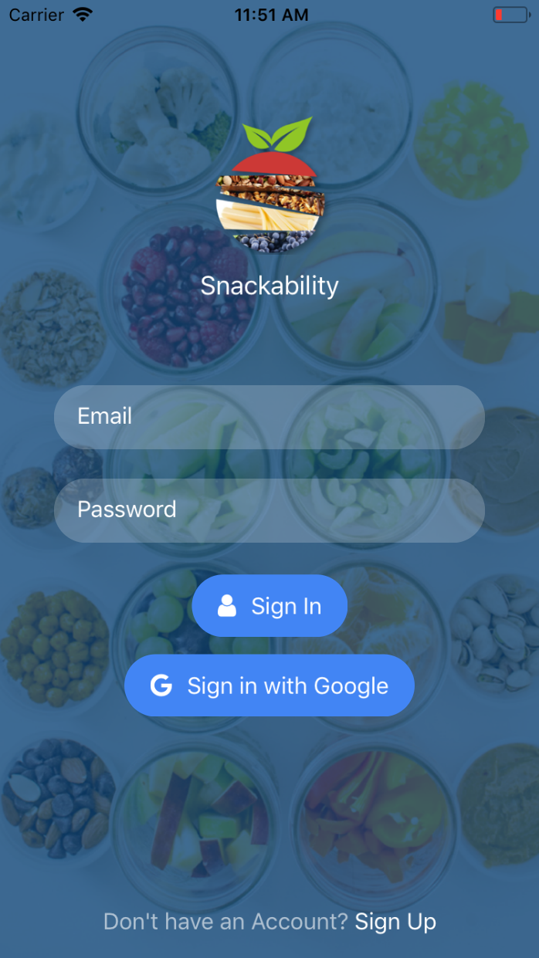
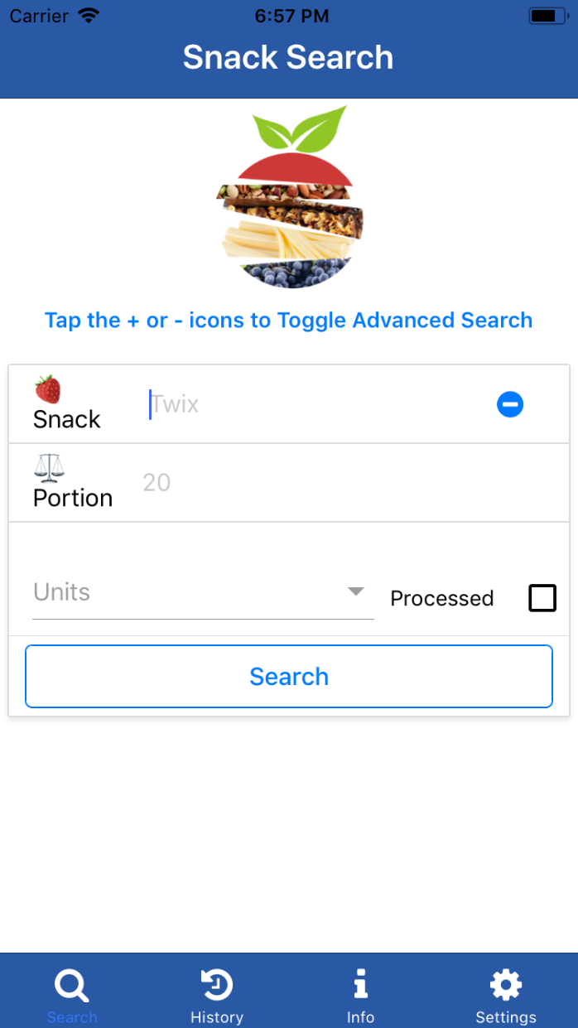
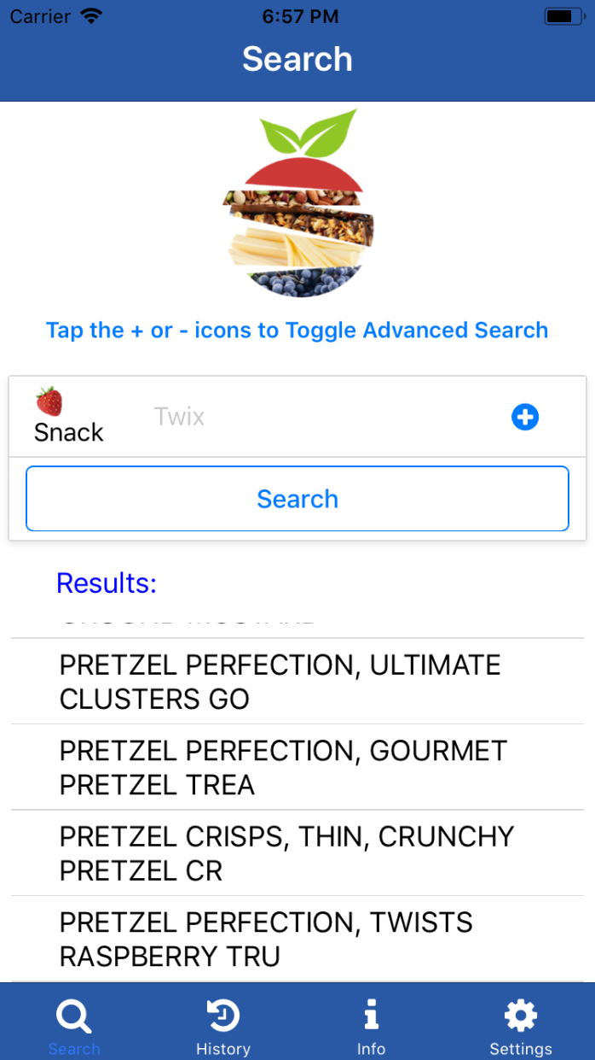
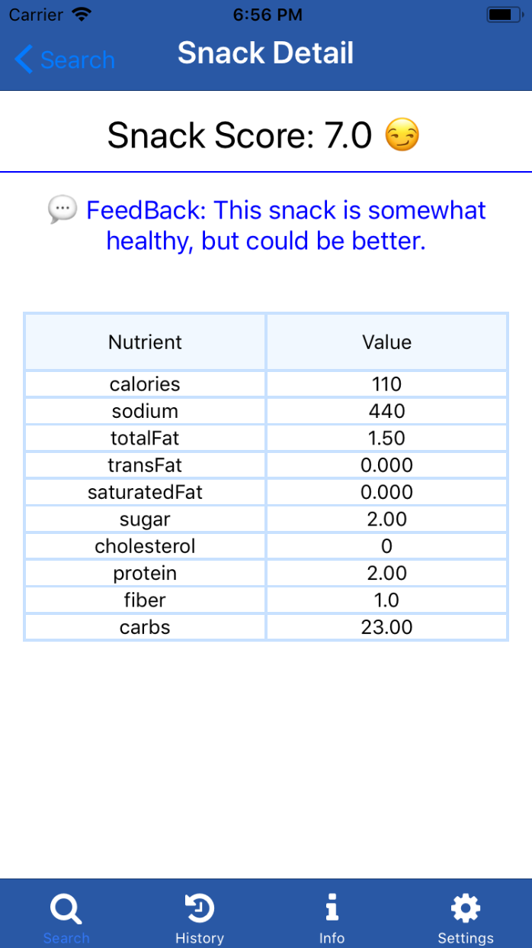
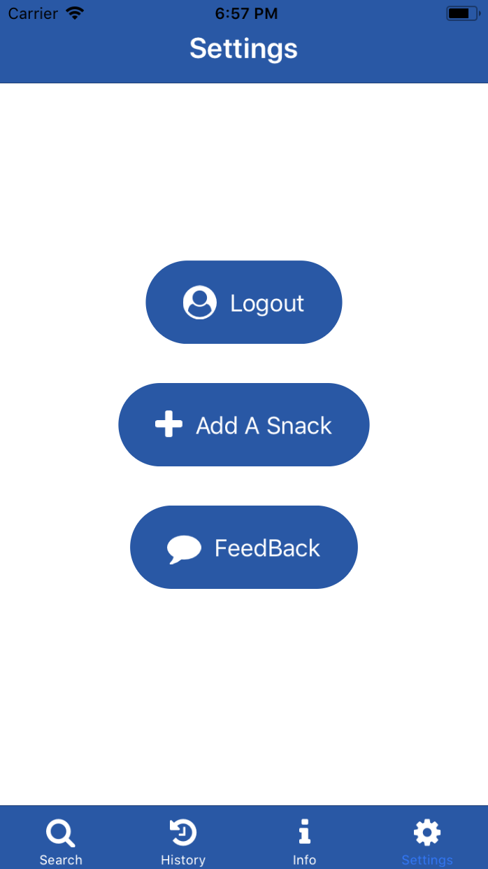
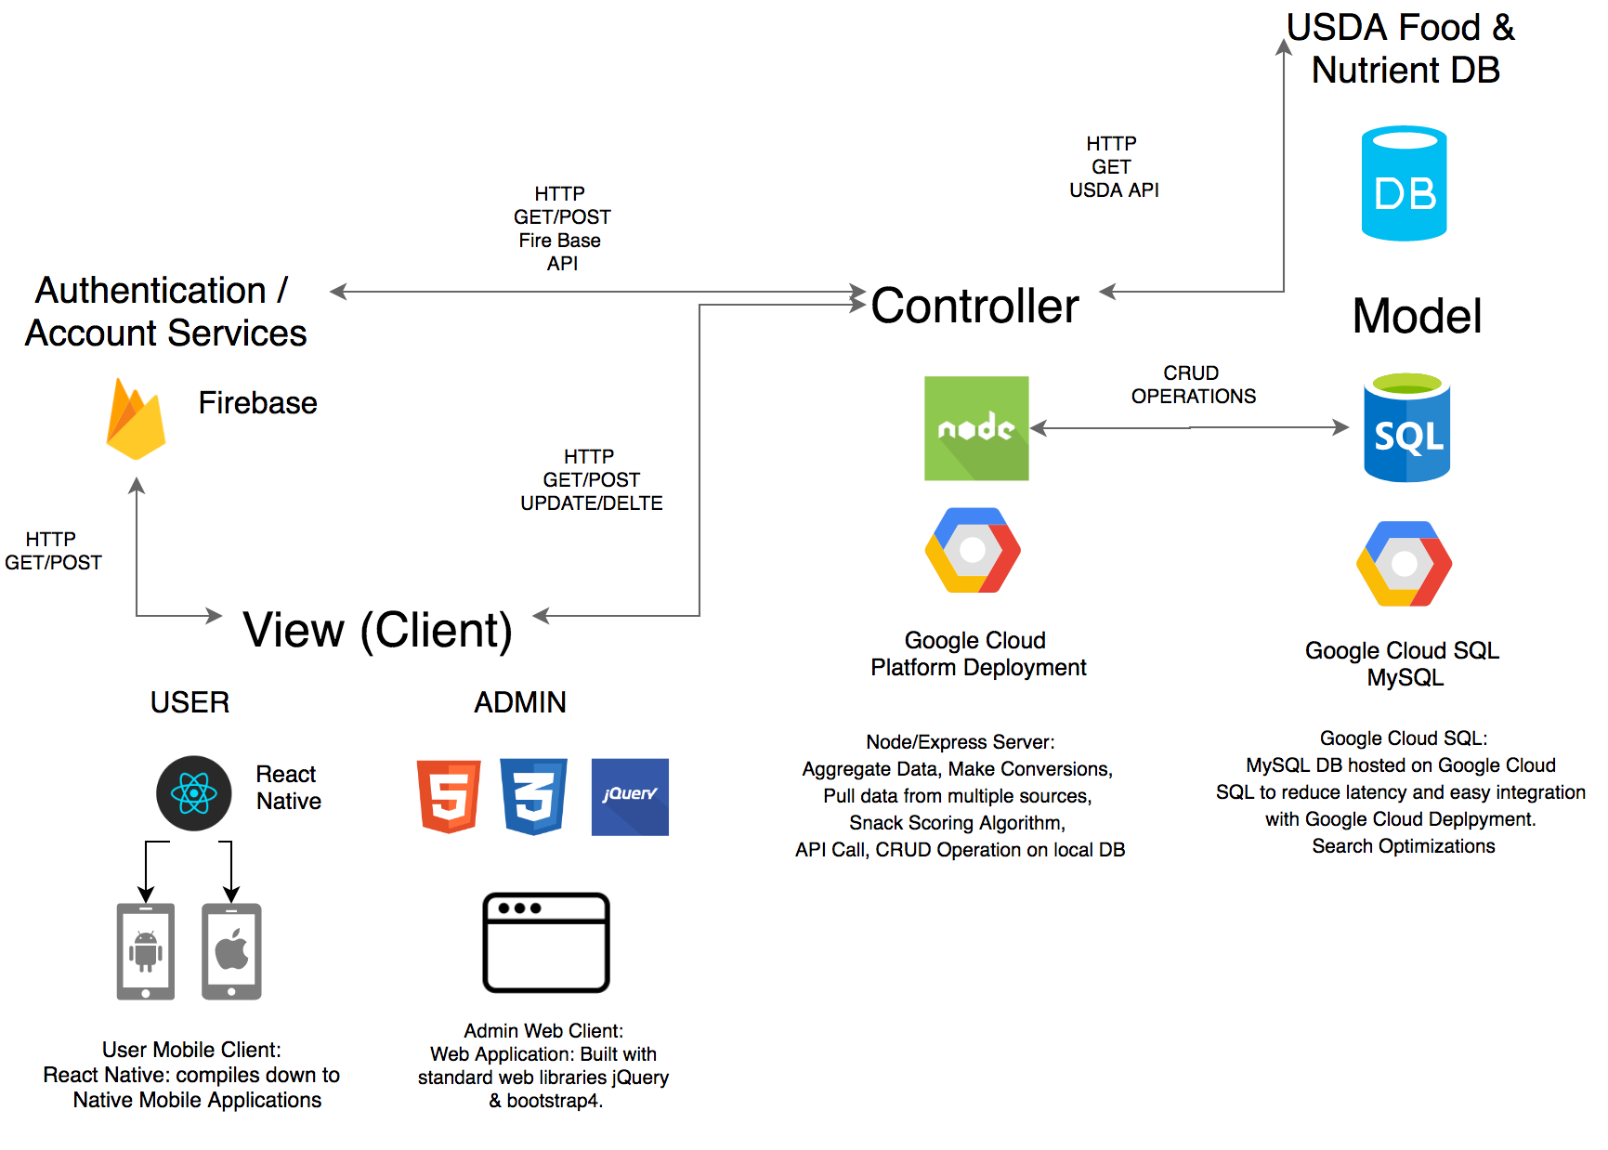
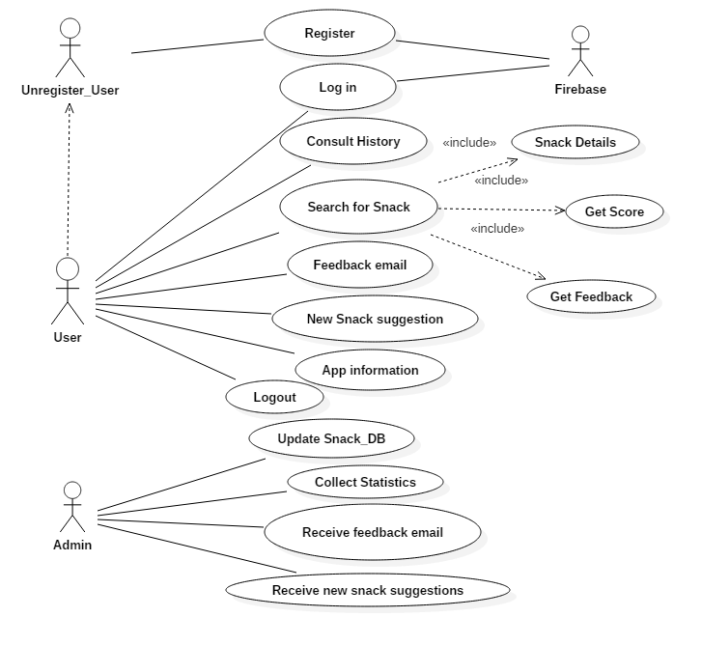
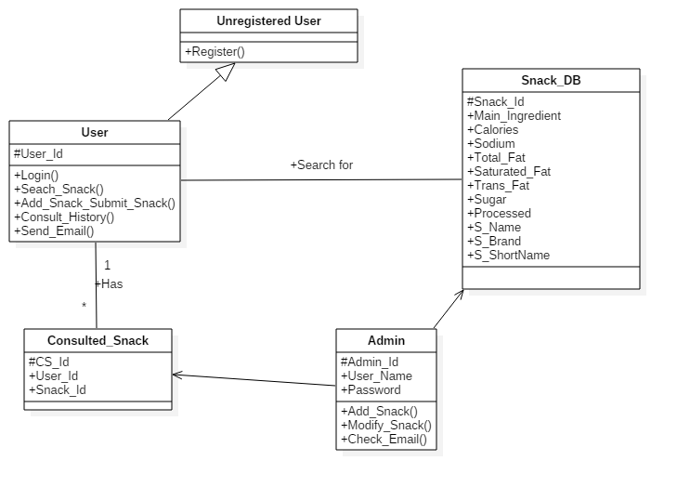
School of Computing & Information Sciences
Senior Project, 2018, Spring
Snackability 1.0
Student: Frank E. Hernandez, Florida International University
Mentor: Dr. Christina Palacios Associate Professor Dietetics & Nutrition
Professor: Masoud Sadjadi, Florida International University
Problem
83% of US adolescents and 98.2%of US college students consume snacks daily the majority of which are deemed unhealthy.
There are is no applications available that define healthy snacks in accordance to current snack guidelines published by the USDA.
Solution
A mobile application to allow users to search for snacks and easily know how healthy the snack they’re searching for is.
A web API backed by a large data source and a curated local database containing all snacks provided on FIU campuses.
A robust 1.0 application that has SOR and a DRY structure.
Current System
Many applications rely on unchecked user entries to provide nutritional information about snacks.
Few apps provide snack scores
There are no apps available to specifically identify if a snack is healthy or not based on the USDA guidelines.
Screenshots
\
Fig. 1 Log in Fig. 2 Advanced Search Fig. 3 Matching Snacks Fig. 4 Snack Detail Fig. 5 Settings Tab
Requirements
Support iOS and Android devices.
User accounts
Local database containing all snacks in FIU campuses.
Access to the USDA database
Use USDA guidelines and scoring algorithm to provide a snack score.
Handle food measurements.
Provide elements of gamification and user feedback.
Collect user metrics.
Suggest snack to be added by the team
Admin portal
System Design
Implementation
React Native leveraged to
build native applications for
both Android & iOS.
Redux used in with react for complex state operations.
Firebase used to authenticate and for user accounts.
Web API built with Node, Express to interface with MySQL DB and USDA API.
Admin site to run CRUD operations on local database.
Phonetic algorithms used to better searches.
Google Cloud Platform was used for deployment.
Verification
Postman tests were created to test various API endpoints.
Mocha+Chai, were used to create unit test for conversions and aggregations.
Application was tested on recent versions of Android and iOS emulators and on physical phones.
Manual checks done to verify accurate snack score and nutrient values.
Object Design
Summary
The objective of this project was to design an app that uses USDA guidelines to provide a numeric score based on a snack’s nutritional information
This project is the first release of Snackability app.
The app is going to have an initial on-campus trial during conducted by the FIU Dietetics and Nutrition Department.
Acknowledgement
The material presented in this poster is based upon the work supported by Dr. Cristina Palacios. I am thankful to the help that I received from my group member Bertha Perez.
Notes:
1

